Slide 1
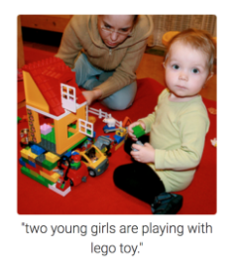
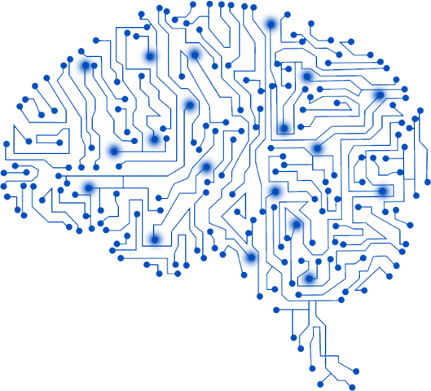
Welcome to the CSE 465 Project Proposal Presentation
Project Title: Automatic Image Caption using CNN and LSTM​ Course: CSE-465 Section: 02 Submitted to: Dr. Mohammad Ashrafuzzaman Khan(Azk)
Name | Student ID
S M Gazzali Arafat Nishan | 1831513642
Rofiqul Alam Shehab | 1831185042
Shafiul Bashar | 1831446642

Slide 2
Background of Image Caption & LSTM
(What is the idea?)
What is an image caption?
Image captions are composed of few sentences that are used to describe or explain the published photographs.
What LSTM?.
Long short-term memory (LSTM) is a deep learning architecture that uses an artificial recurrent neural network (RNN). In many cases, LSTM has an advantage over RNNs, hidden Markov models, and other sequence learning approaches due to its relative insensitivity to gap length.

Slide 3
Objective & Motivation
The objective of this project is to develop an Automatic Image Caption which is integrated with CNN and LSTM to make it reliable image caption generator.
Objective
Motivation
Automatic image caption applications make the services more accessible.
3

Slide 4
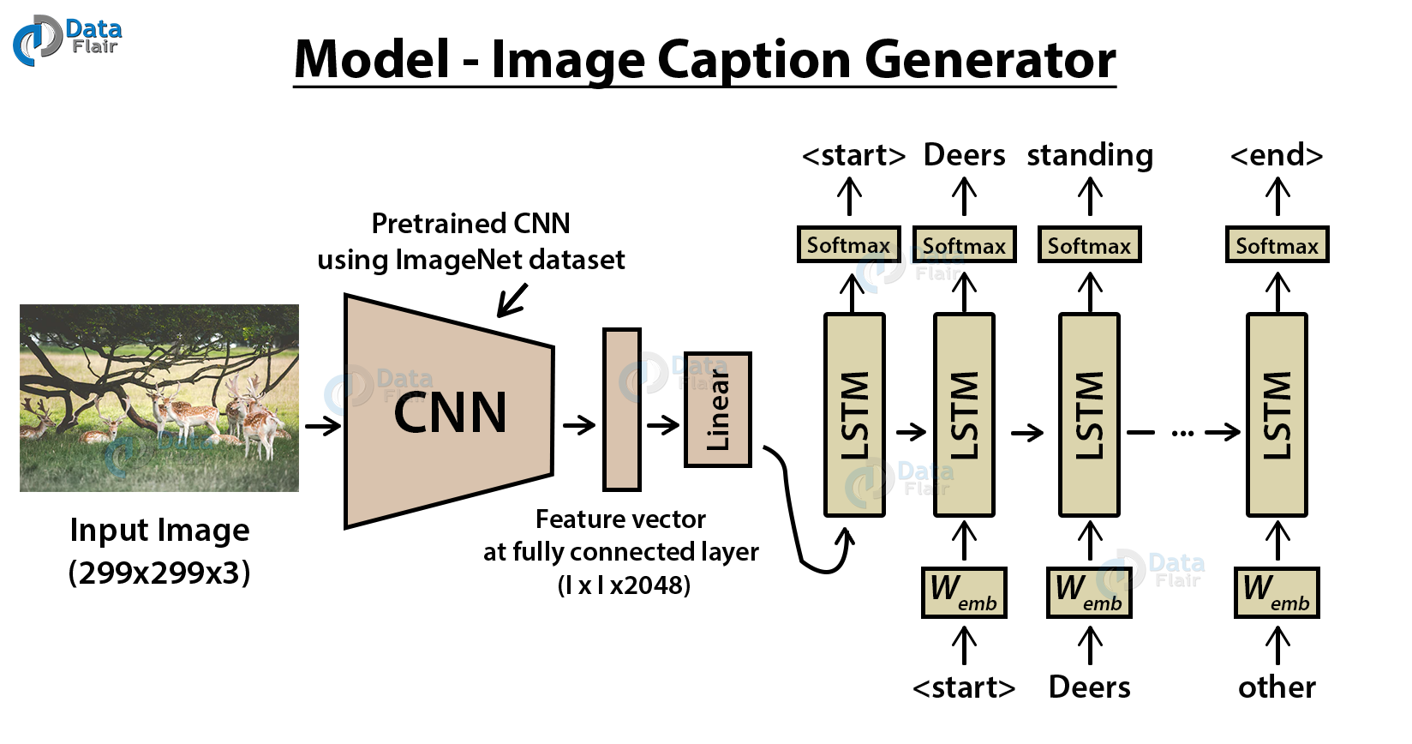
4

Slide 5
Required Software & Datasets
.
The Software specifications will be used in this study are as follows:
Python 3
Py Torch
COCO dataset: Large-scale object detection, segmentation, and captioning dataset. COCO has several features:
Recognition in context
Super pixel stuff segmentation
330K images (>200K labeled)
1.5 million object instances
80 object categories
91 stuff categories
250,000 people with key points
https://cocodataset.org/
5

Slide 6
Related Work
Learn to Build Image Caption Generator with CNN & LSTM: https://data-flair.training/blogs/python-based-project-image-caption-generator-cnn/
Automatic Image Caption Generation: https://github.com/juletx/image-caption-generation
Automatic Image Captioning using Deep Learning (CNN and LSTM) in PyTorch: https://www.analyticsvidhya.com/blog/2018/04/solving-an-image-captioning-task-using-deep-learning/
Deep Learning based Automatic Image Caption Generation: https://ieeexplore.ieee.org/abstract/document/8978293
6

Slide 7
Thank You

